Slide 1


BDAT1001 – 04 Information Encoding Standards Authorization and Authentication
Group 3
Ching Yu Kwan (200517522)
Dan Owusu(200509765)
Yu-Ju Wang (200458314)

Slide 2
Agenda
Part1: Create an ASP.NET Core web app with user data protected by authorization
Web App Creation
Secure user data
Create owner, manager, and administrator authorization handlers
Register the authorization handlers
Inject the authorization service into the views
Allow anonymous users
Part2: Security Technologies Recommendations

Slide 3
Part 1
Create an ASP.NET Core web app with user data protected by authorization

Slide 4
Create the Starter App
.

Slide 5
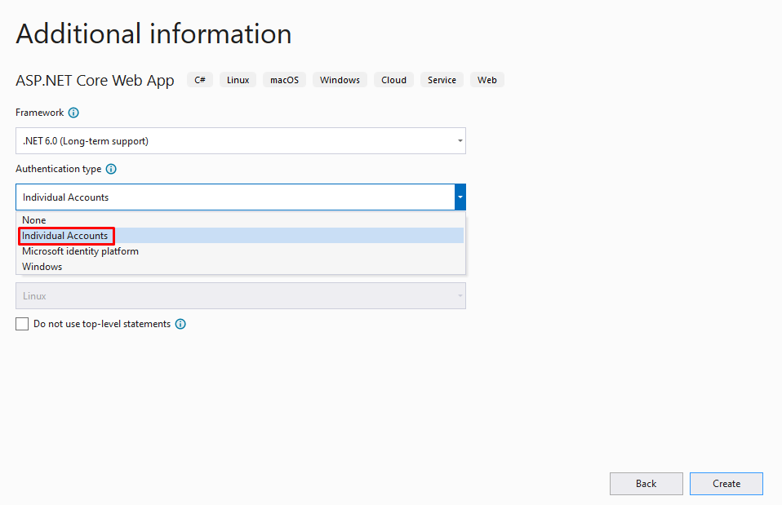
Create the starter app
Authentication type – Individual Accounts

Slide 6
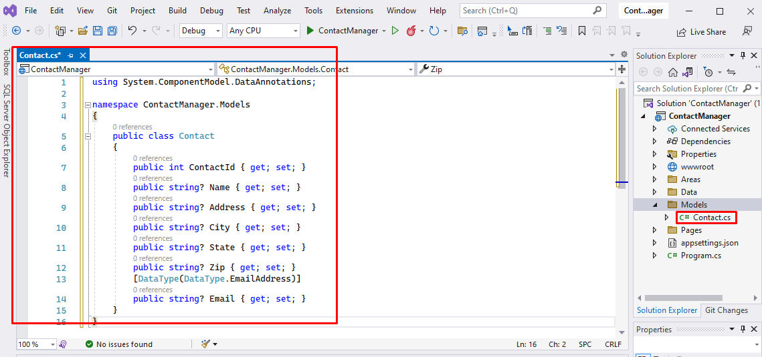
Create the starter app
Add new folder “Models”
Add new class Contact.cs under Models folder
Input code

Slide 7
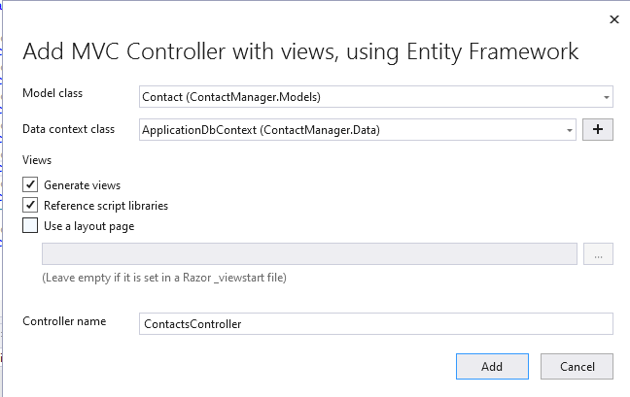
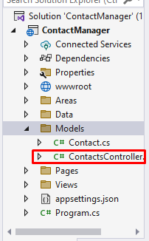
Create the starter app
Add new scaffold MVC controller ContactsController under Models folder

Slide 8
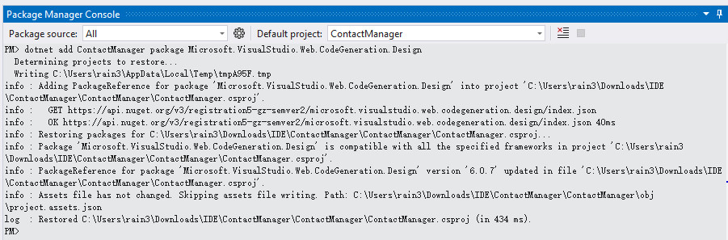
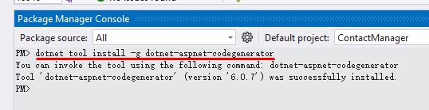
Create the starter app
Run “dotnet add ContactManager package Microsoft.VisualStudio.Web.CodeGeneration.Design” in PMC
Install “dotnet-aspnet-codegenerator” --- dotnet tool install -g dotnet-aspnet-codegenerator

Slide 9
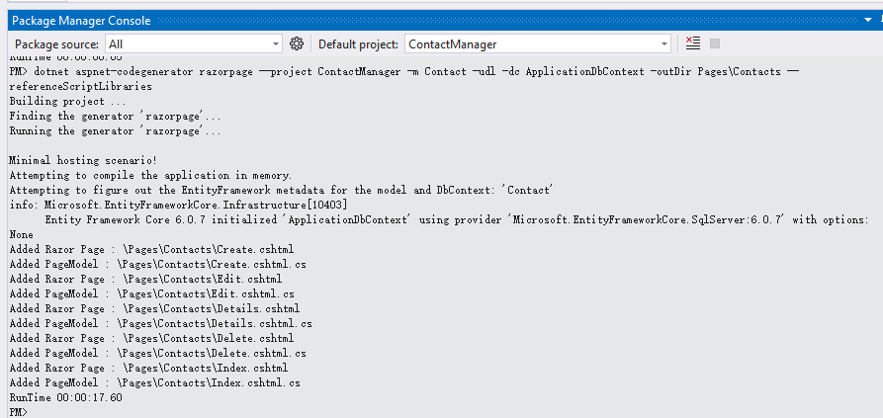
Create the starter app
Scaffold Contact Model --- dotnet aspnet-codegenerator razorpage -m Contact -udl -dc ApplicationDbContext -outDir Pages\Contacts --referenceScriptLibraries

Slide 10
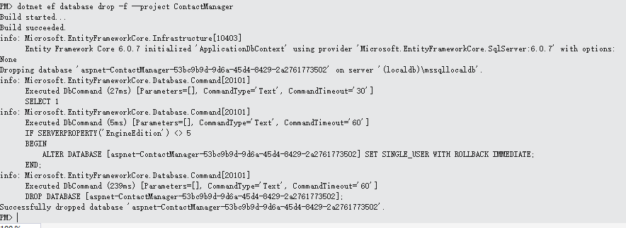
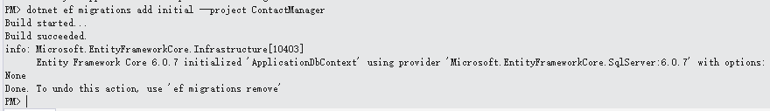
Create the starter app
Drop the database --- dotnet ef database drop –f –project ContactManager
Add a new migration and named initial

Slide 11
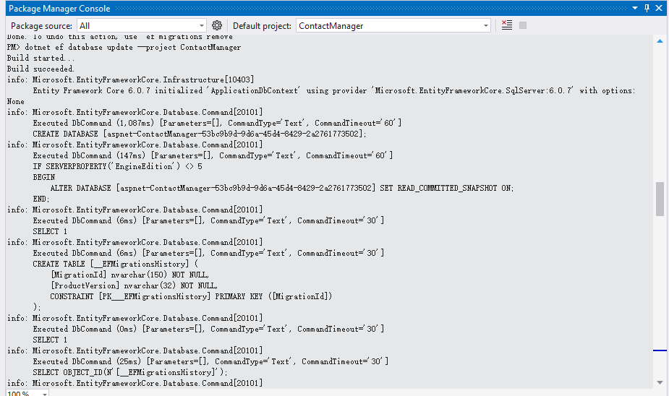
Create the starter app
Update database --- dotnet ef database update

Slide 12
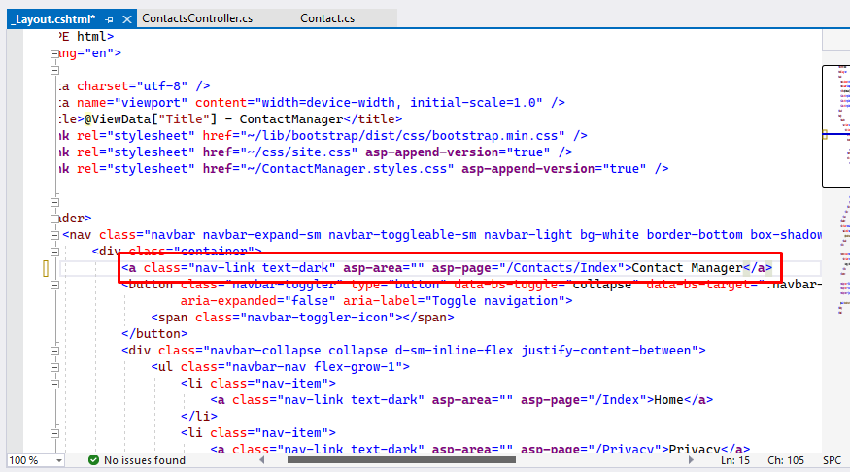
Create the starter app
Update the ContactManager anchor in the Pages/Shared/_Layout.cshtml file

Slide 13
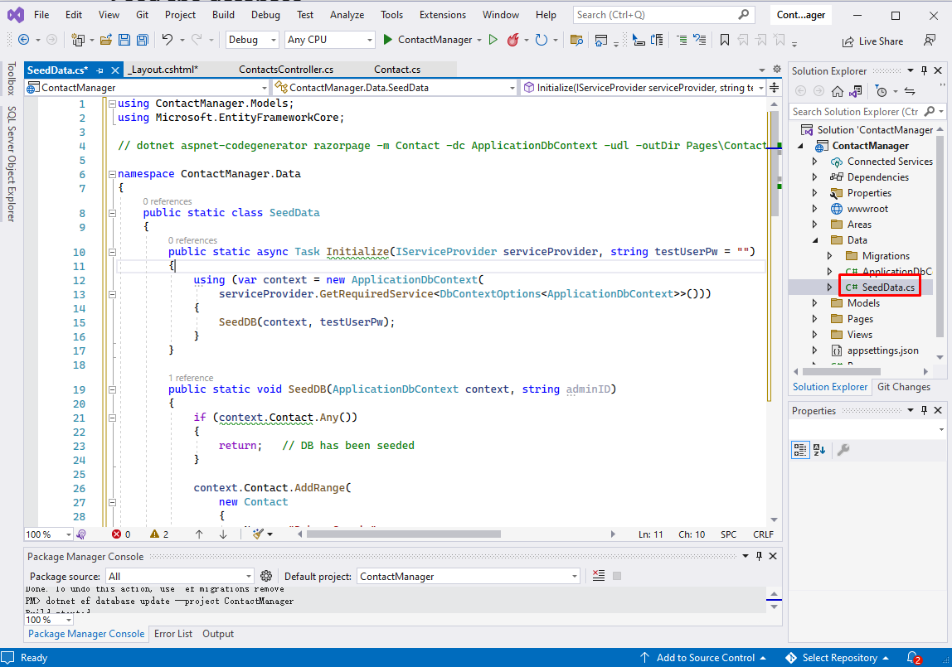
Create the starter app
Add the SeedData class to the Data folder

Slide 14
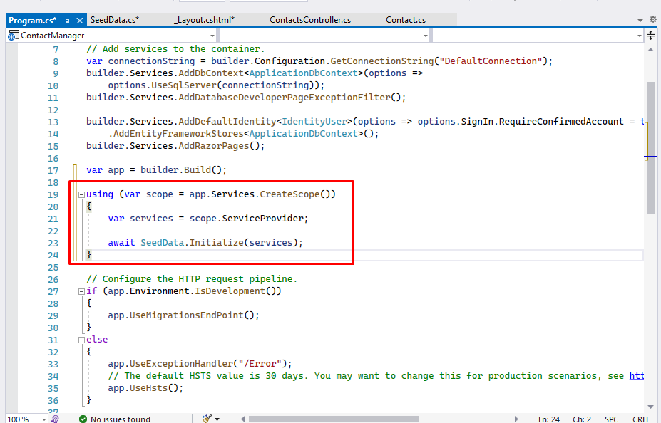
Create the starter app
Add code in Program.cs to call SeedData.Initialize

Slide 15
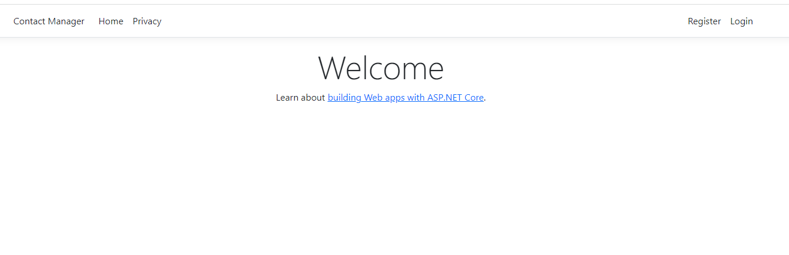
Create the starter app
Save all and run the program to access to the app

Slide 16
Secure User Data
.

Slide 17
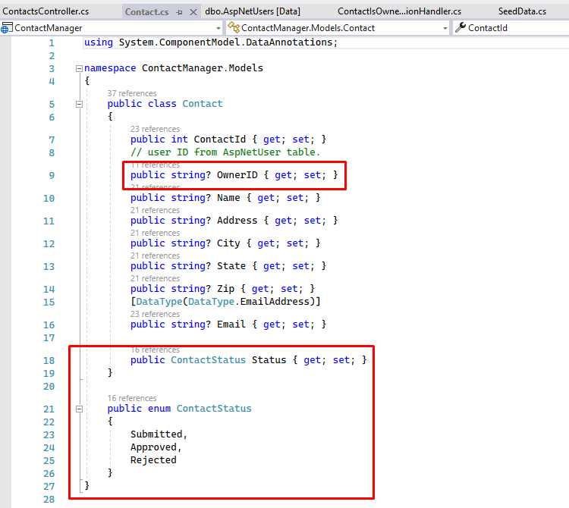
Tie the contact data to the user
Add OwnerID and ContactStatus to the Contact model
Notes:
OwnerID is the user's ID from the AspNetUser table in the Identity database. The Status field determines if a contact is viewable by general users.

Slide 18
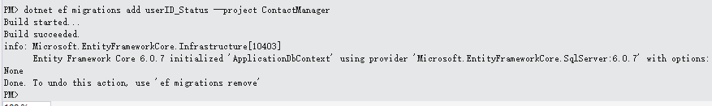
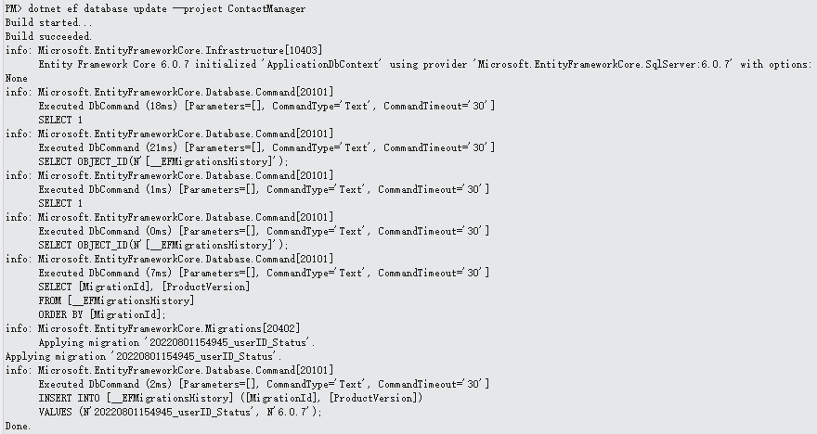
Tie the contact data to the user
Create a new migration and update the database

Slide 19
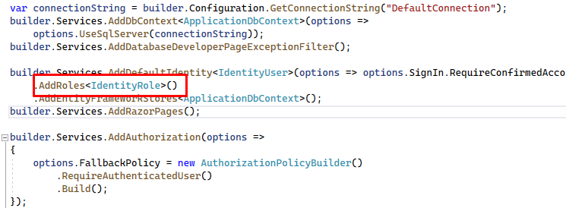
Add Role services to Identity
Append AddRoles to add Role services
Notes:
The code is to set the fallback authorization policy which requires all users to be authenticated.
RequireAuthenticatedUser adds DenyAnonymousAuthorizationRequirement to the current instance, which enforces that the current user is authenticated.

Slide 20
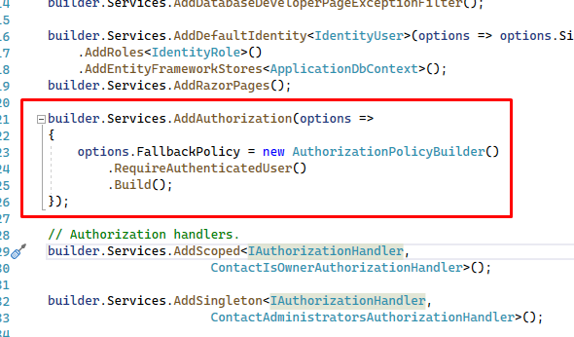
Require authenticated users
Set the fallback authorization policy to require users to be authenticated

Slide 21
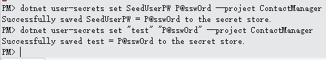
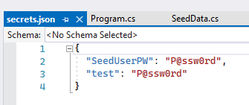
Configure the test account
Set secrets – donet user-secrets set SeedUserPW P@ssw0rd – project ContactManager
Notes:
The SeedData class creates two accounts: administrator and manager. We used the Secret Manager tool to set a password for these accounts.

Slide 22
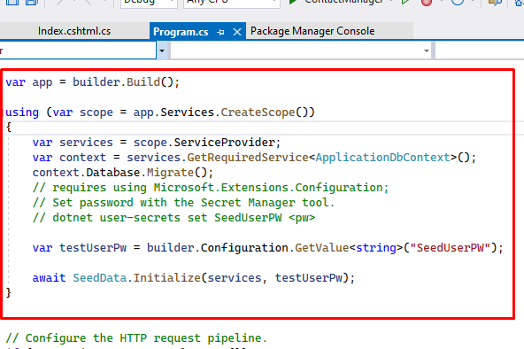
Configure the test account
Update the app to use the test password

Slide 23
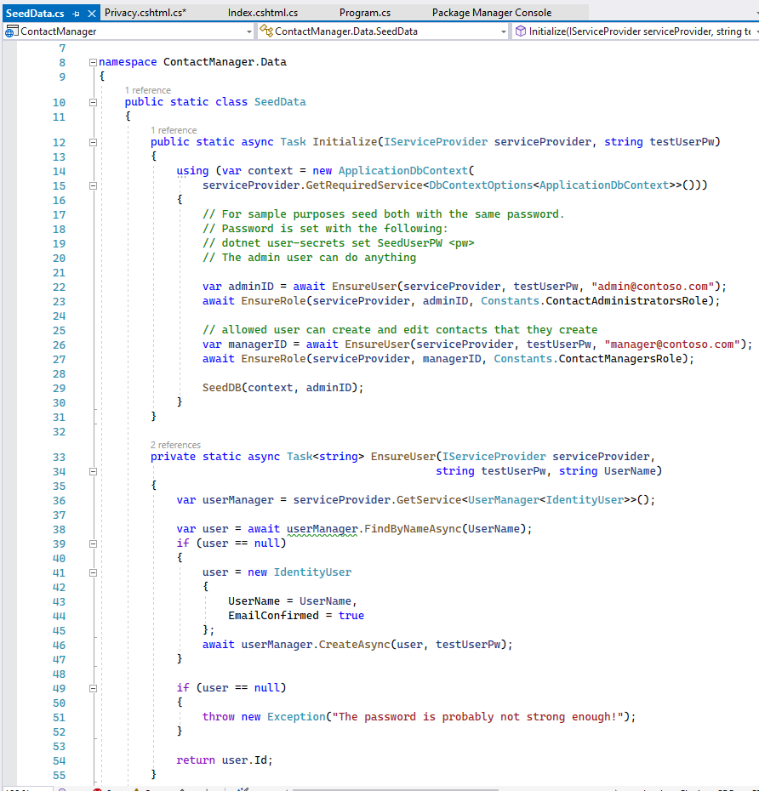
Create the test accounts and update the contacts
Update the Initialize method in the SeedData class to create the test accounts

Slide 24
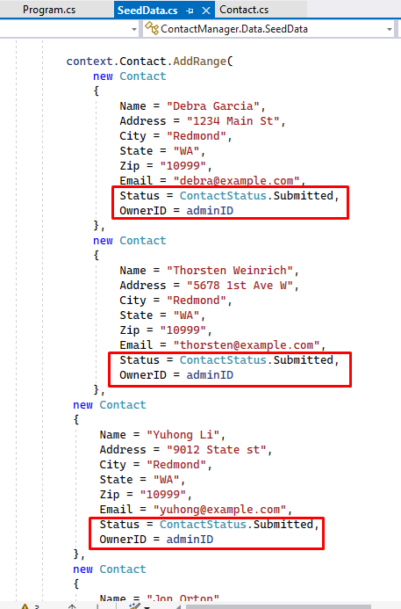
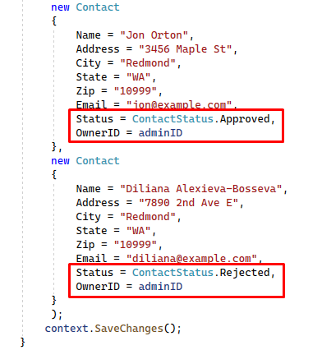
Create the test accounts and update the contacts
Add the administrator user ID and ContactStatus to the contacts.

Slide 25
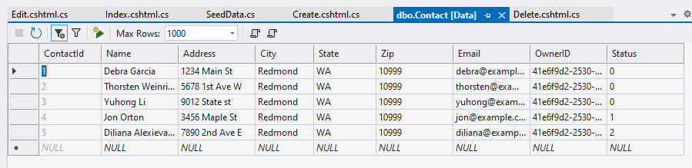
Create the test accounts and update the contacts
Add the administrator user ID and ContactStatus to the contacts.

Slide 26
Create and Register owner, manager, and administrator authorization handlers
.

Slide 27
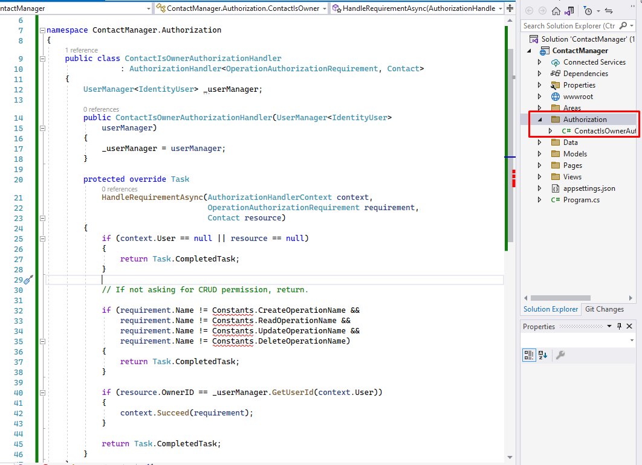
Create owner authorization handlers
Create a ContactIsOwnerAuthorizationHandler class in the Authorization folder
Notes:
To verify that the user acting on a resource owns the resource.
The ContactIsOwnerAuthorizationHandler calls context.Succeed if the current authenticated user is the contact owner. Authorization handlers generally:
Call context.Succeed when the requirements are met.
Return Task.CompletedTask when requirements aren't met, it allows other authorization handlers to run

Slide 28
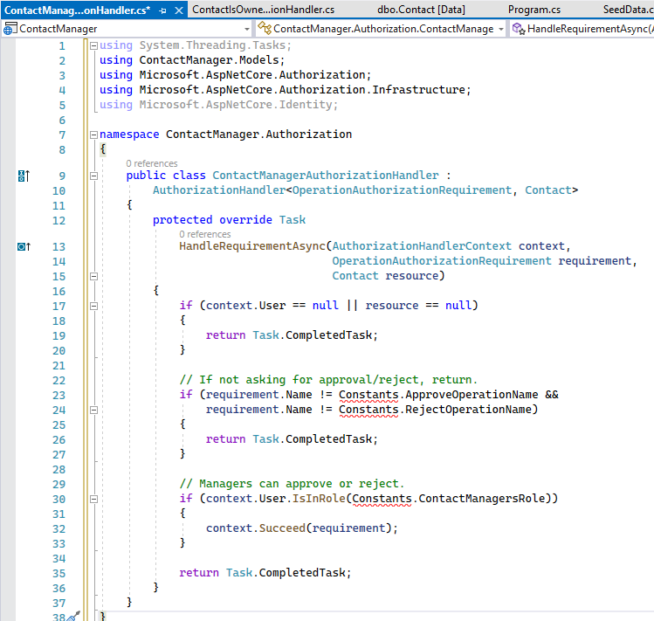
Create a manager authorization handler
Create a ContactManagerAuthorizationHandler class in the Authorization folder
Notes:
The ContactManagerAuthorizationHandler verifies the user acting on the resource is a manager. Only managers can approve or reject content changes

Slide 29
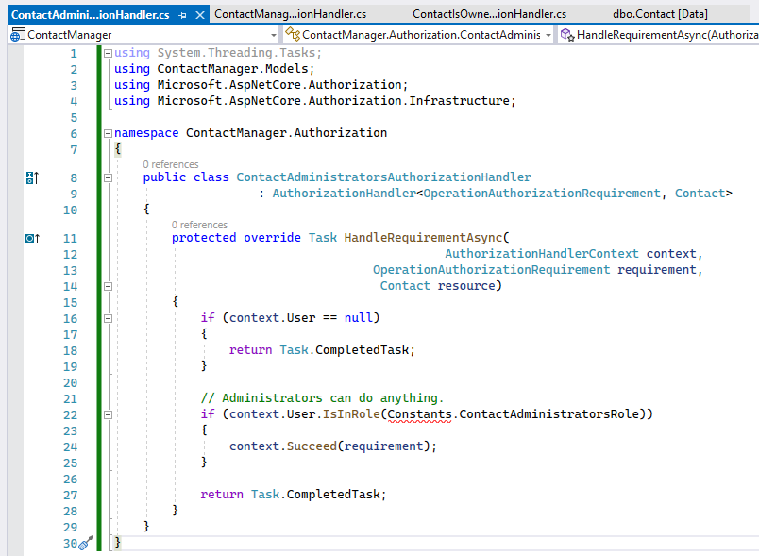
Create an administrator authorization handler
Create a ContactAdministratorsAuthorizationHandler class in the Authorization folder
Notes:
The ContactAdministratorsAuthorizationHandler verifies the user acting on the resource is an administrator. Administrator can do all operations.

Slide 30
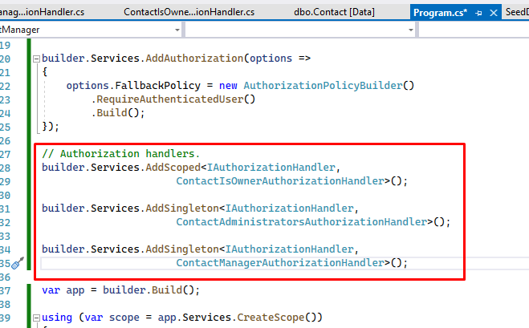
Register the authorization handlers
Register the handlers with the service collection
Notes:
Services using Entity Framework Core must be registered for dependency injection using AddScoped. The ContactIsOwnerAuthorizationHandler uses ASP.NET Core Identity, which is built on Entity Framework Core. Register the handlers with the service collection so they're available to the ContactsController through dependency injection.

Slide 31
Support authorization
.

Slide 32
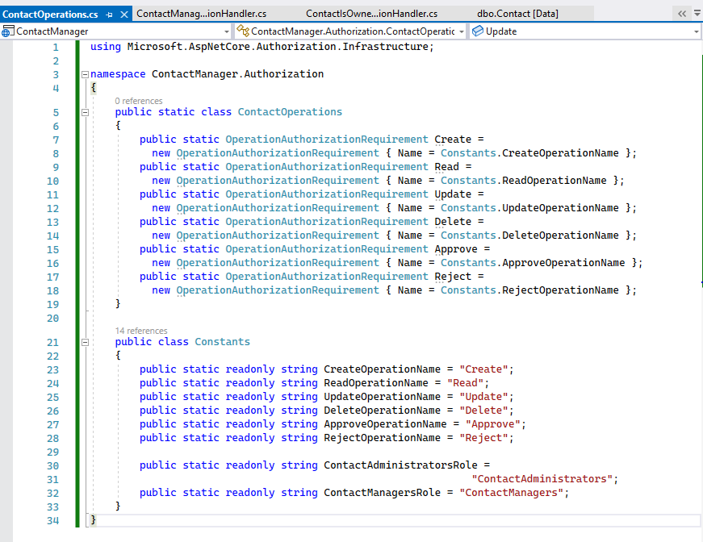
Review the contact operations requirements class
Add the ContactOperations class
Notes:
This class contains the requirements the app supports

Slide 33
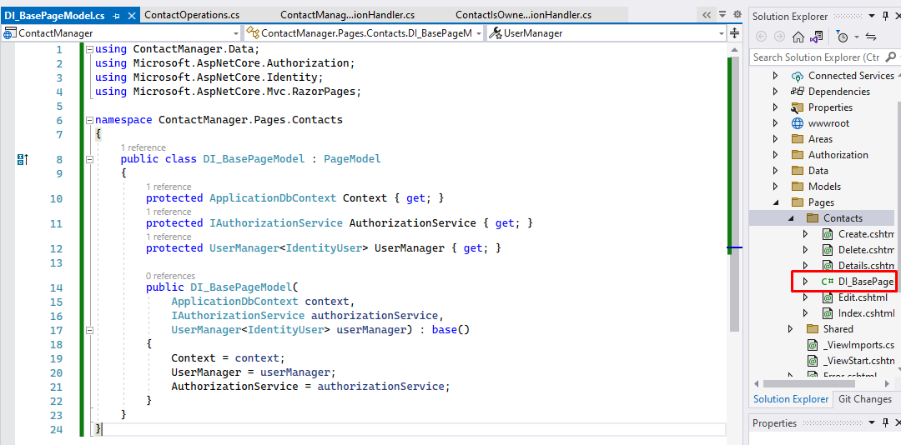
Create a base class for the Contacts Razor Pages
Create a base class that contains the services used in the contacts Razor Pages
Notes:
The base class puts the initialization code in one location
The code
Adds the IAuthorizationService service to access to the authorization handlers.
Adds the Identity UserManager service.
Add the ApplicationDbContext.

Slide 34
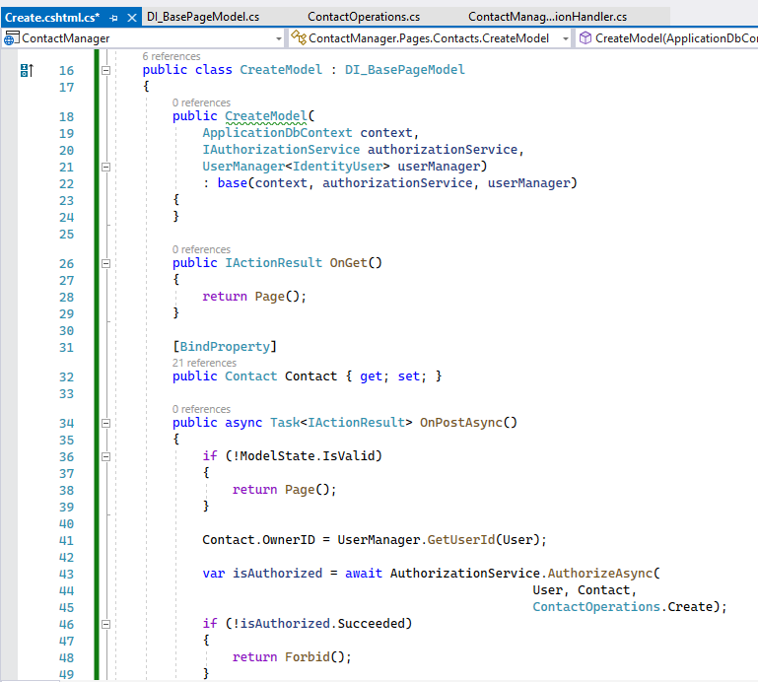
Update the Create Model
Update the create page model
Notes:
Constructor to use the DI_BasePageModel base class.
OnPostAsync method to:
Add the user ID to the Contact model.
Call the authorization handler to verify the user has permission to create contacts.

Slide 35
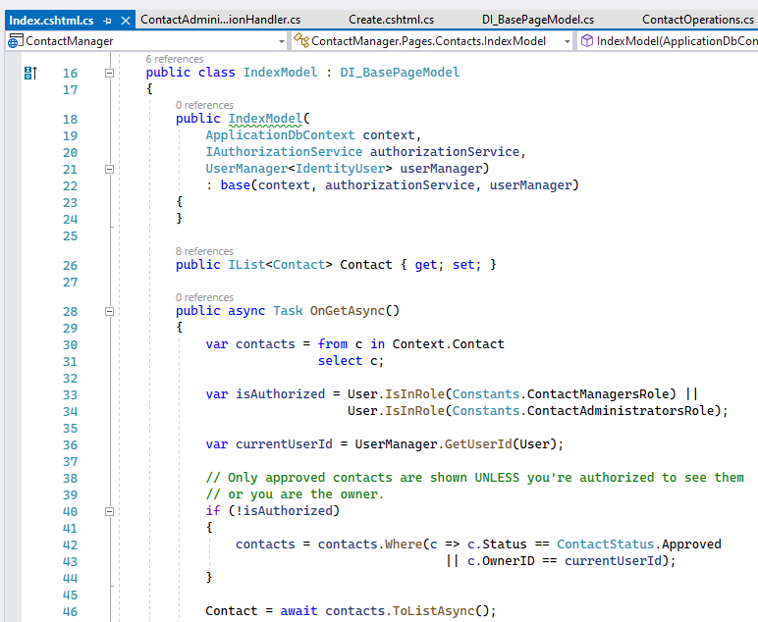
Update the IndexModel
Update the IndexModel
Notes:
Update the OnGetAsync method so only approved contacts are shown to general users

Slide 36
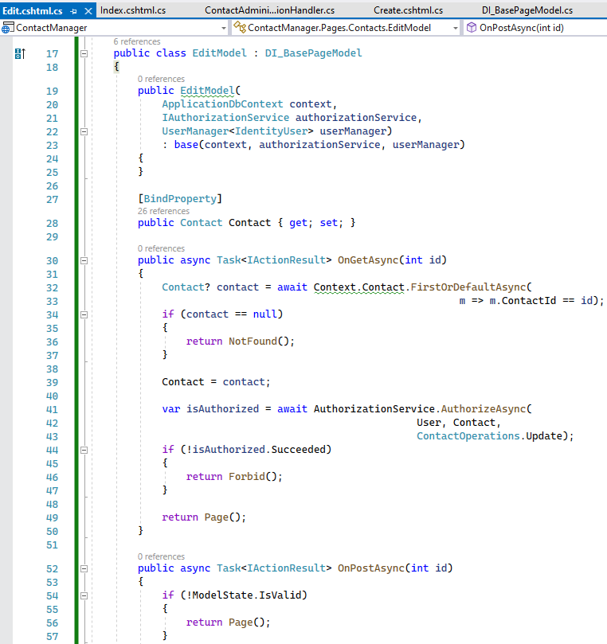
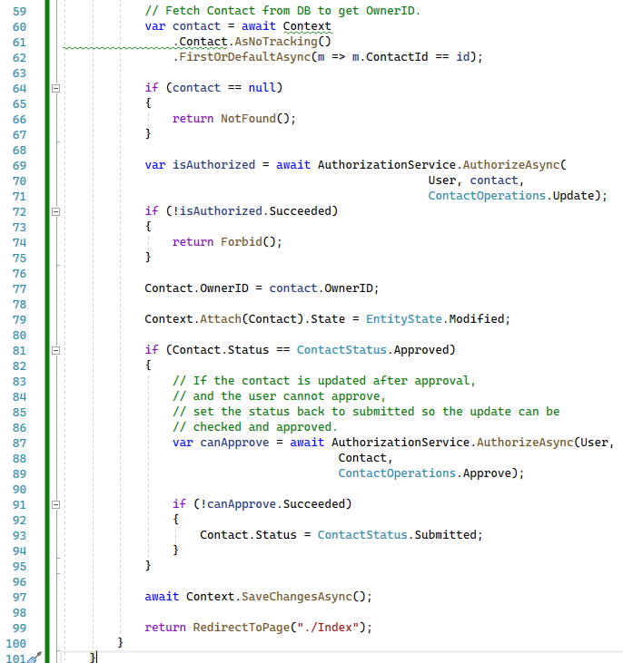
Update the EditModel
Update the EditModel
Notes:
We Added an authorization handler to verify the user owns the contact.
Because resource authorization is being validated, the [Authorize] attribute is not enough. The app doesn't have access to the resource when attributes are evaluated. Resource-based authorization must be imperative. Checks must be performed once the app has access to the resource, either by loading it in the page model or by loading it within the handler itself.

Slide 37
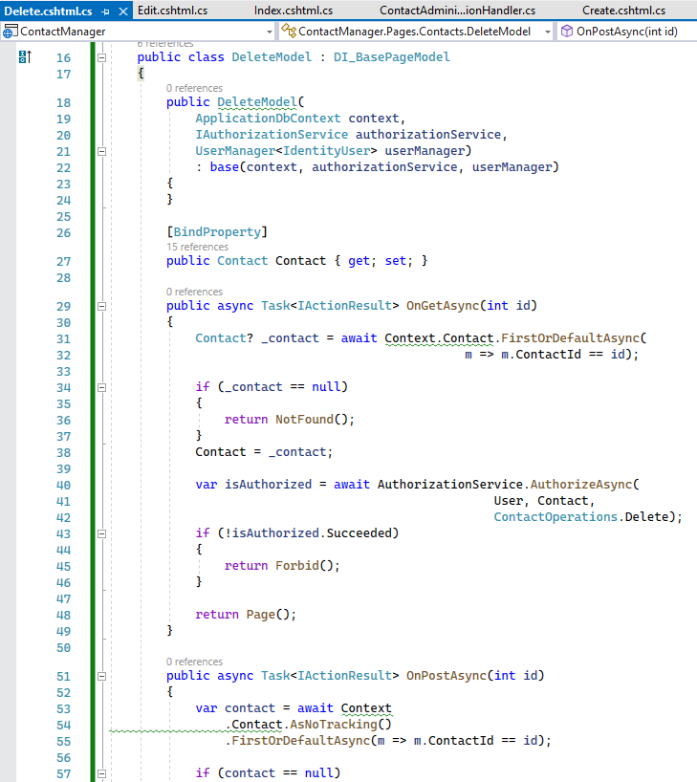
Update the DeleteModel
Update the delete page model
Notes:
Update the delete page model to use the authorization handler to verify the user has delete permission on the contact.

Slide 38
Inject the authorization service into the views
.

Slide 39
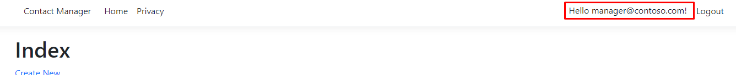
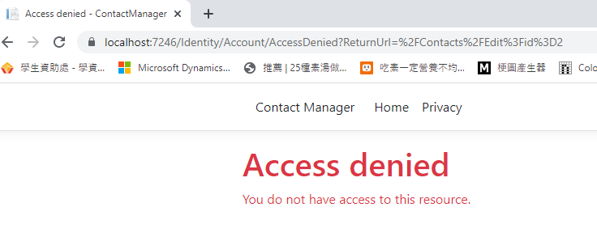
Inject the authorization service into the views
Currently, the UI shows edit and delete links for contacts but the user can't modify

Slide 40
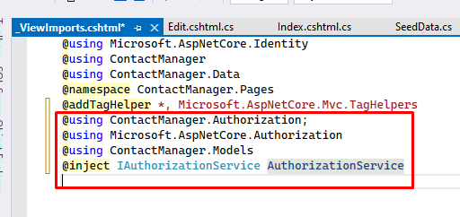
Inject the authorization service into the views
Inject the authorization service in the Pages/_ViewImports.cshtml file

Slide 41
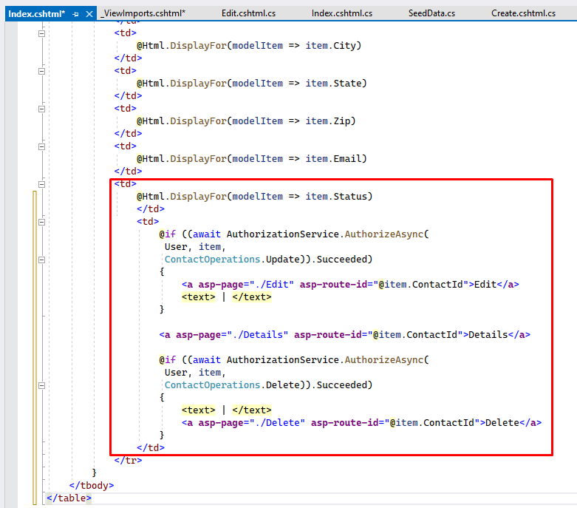
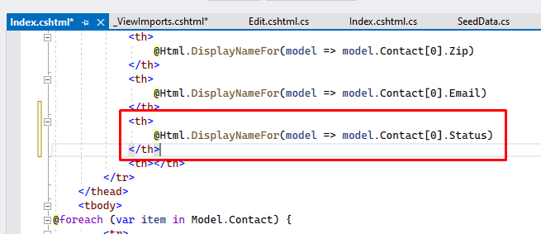
Inject the authorization service into the views
Update the Edit and Delete links in Pages/Contacts/Index.cshtml

Slide 42
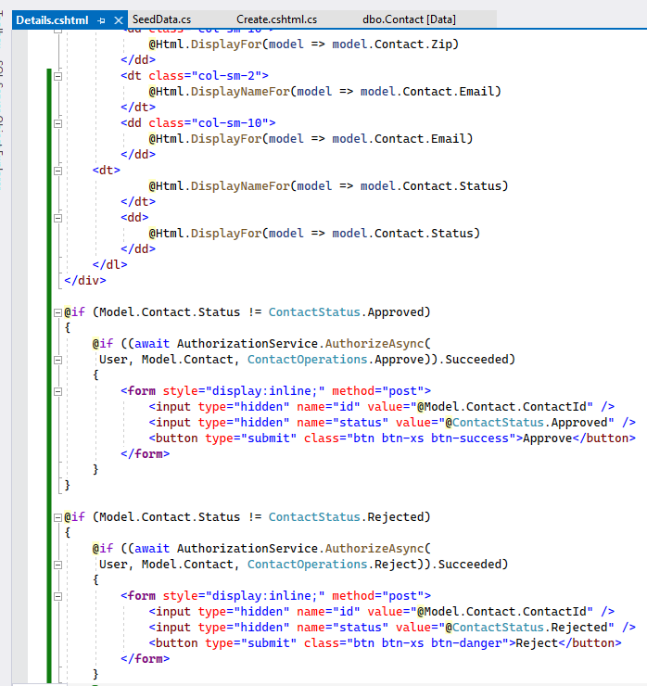
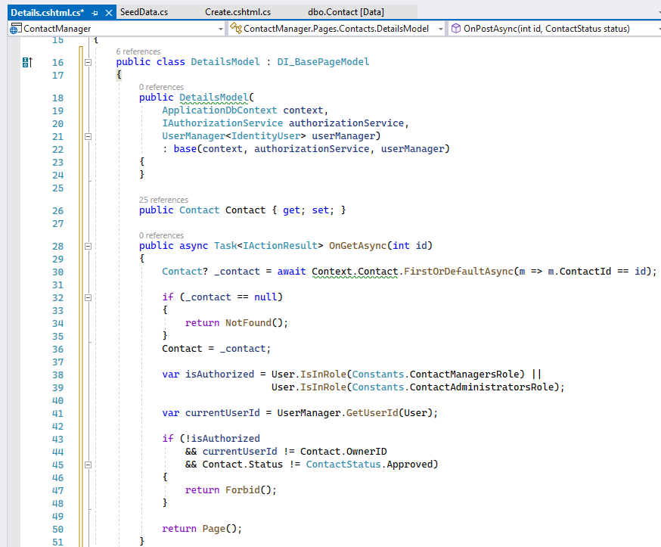
Update the Details
Update the details view and the details page model

Slide 43
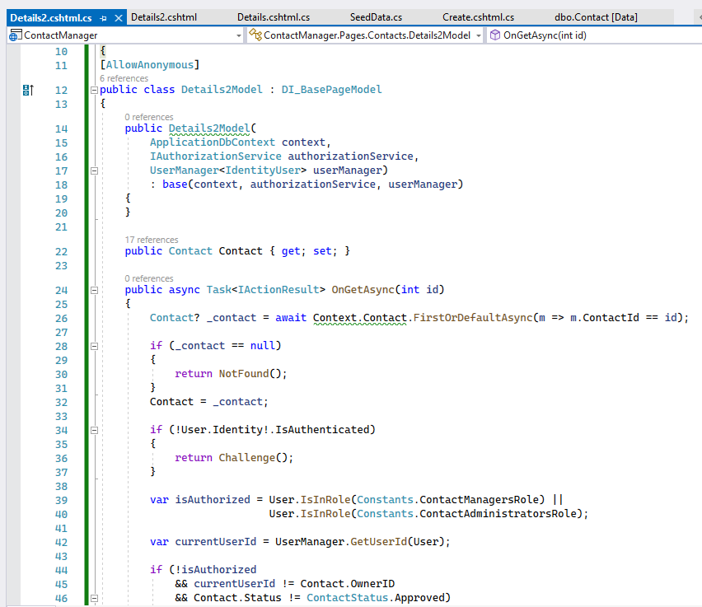
Differences between Challenge and Forbid
The code allows anonymous users
Notes:
This app sets the default policy to require authenticated users. The following code allows anonymous users. Anonymous users are allowed to show the differences between Challenge vs Forbid

Slide 44
Testing the App
.

Slide 45
Testing the App
User | Approve or reject contacts | Options
test@example.com | No | Edit and delete their data.
manager@contoso.com | Yes | Edit and delete their data.
admin@contoso.com | Yes | Edit and delete all data.

Slide 46
Part 2
Security Technologies Recommendations

Slide 47
How can we transfer personal data securely within a company’s network?
Network Protocols
Determine how data is transmitted in the same network
How to format, transmit and receive data
computer network devices can communicate
regardless of the differences in their underlying infrastructures, designs or standards
Notes:
Source: https://www.techtarget.com/searchnetworking/definition/protocol
How can we transfer personal data securely within a company’s network?
We can use Network Protocols to do so.
It is an established set of rules that determine how data is transmitted between different devices in the same network
It dictates how to format, transmit and receive data so that computer network devices -- from servers and routers to endpoints -- can communicate, regardless of the differences in their underlying infrastructures, designs or standards

Slide 48
What security protocol is best for transferring personal files?
Secure File Transfer Protocol
built on Secure Shell cryptography
encrypt data being transferred
the full security and authentication functionality of SSH
the use of key pairs and host-based authentication
making SFTP useful for sensitive data
protects against password sniffing and man-in-the-middle attacks
protects the integrity of the data using encryption and cryptographic hash functions, and authenticates both the server and the user.
Notes:
Source
https://www.ssh.com/academy/ssh/sftp
What security protocol is best for transferring personal files?
Secure File Transfer Protocol should be the most suitable one because
It is built on Secure Shell cryptography to encrypt data being transferred
It supports the full security and authentication functionality of SSH
It supports the use of key pairs as well as host-based authentication, making SFTP useful for sensitive data such as personally information
SFTP also protects against password sniffing and man-in-the-middle attacks. It protects the integrity of the data using encryption and cryptographic hash functions, and authenticates both the server and the user.

Slide 49
Can we encode and encrypt images?
Images can be encrypted
the binary data that comprises an image can be encrypted
For example:
Image -> Encrypt -> B64Encode -> SaveFile
ReadFile -> B64Decode -> Decrypt -> Image
Notes:
Can we encode and encrypt images?
Similar to how software encrypts texts, an image can also be encrypted.
By running algorithm, the binary data that comprises an image can be encrypted, like how encrypted text
For example:
Image -> Encrypt -> B64Encode -> SaveFile
ReadFile -> B64Decode -> Decrypt -> Image

Slide 50
Our database cannot be moved from the site and we need to be able to access it externally using a secure API. Can you explain the architecture of a secure API?
Authentication and Authorization
secure access to content on your server
Authentication confirms user identity
Authorization determines what resources users get access
Token-based security
OAuth Authentication
JSON Web Token
Notes:
There are four layers of secure API architecture
The information Mangement layer manages the database systems and all data storage systems.
The application layer is where the applications run live. It describes the structure, behavior, and interaction of the applications of the enterprise.
The Integration layer consists of adapters such as the enterprise service BUS (ESB), publish channels inserting, update and delete, and integration controls for evaluating purposes.
The interaction layer is where clients' applications and services interact with organization applications and data.
We need authentication and authorization to secure the API
We use authorization in combination with authentication to secure access to content on your server.
Authentication confirms the identity of a user, while authorization determines what resources users can or cannot access.
Token-based security is commonly used in today’s security architecture.
OAuth Authentication is an open standard for token-based authentication and authorization on the Internet.
JWT is a popular user authentication standard, used to securely exchange information online.

Slide 51
Can you recommend a secure framework for coding an API?
OAuth
Able to grant a third-party web site / application access to protected resources without revealing long-term credentials or identity
Limited access to a user's data without giving away a user's password
Notes:
Always use HTTPS
Do not expose information on URLs such as API key
Timestamp must be added to request
Use Parameter Validation and reject requests immediately when it fails
Use OAuth which allows third-party applications limited access
We would recommend OAuth. It is a delegated authorization framework for REST/APIs
It allows a user to grant a third-party web site or application access to the user's protected resources, without necessarily revealing their long-term credentials or even their identity
It means that it enables apps to obtain limited access to a user's data without giving away a user's password, giving it the ability to share data for users without having to release personal information

Slide 52
What data interchange format should we use while transferring data between locations?
JavaScript Object Notation (JSON)
Open-standard data format for semi- structured data
Text-based - Readable by humans and machines
Common for transferring data between servers and web applications
those applications can often only receive data as text - JSON is text-based
Benefit:
Can easily be sent to and from a server and used by any programming language
Data can be used like any other JavaScript object
Store data in nested objects and arrays which contain values themselves - highly adaptable
Simple design, flexibility, and ease of use and understanding

Slide 53
How should we store our data in our many locations?
Manage access to sensitive information
Encrypt everything
Protect user data at the source
Notes:
Cloud storage
Cloud storage allows for backup
Remotely update & sync your files
Files are easily shared and working remotely on the files are easier
Files stored on cloud storage are encrypted and stored for a lifetime

Slide 54
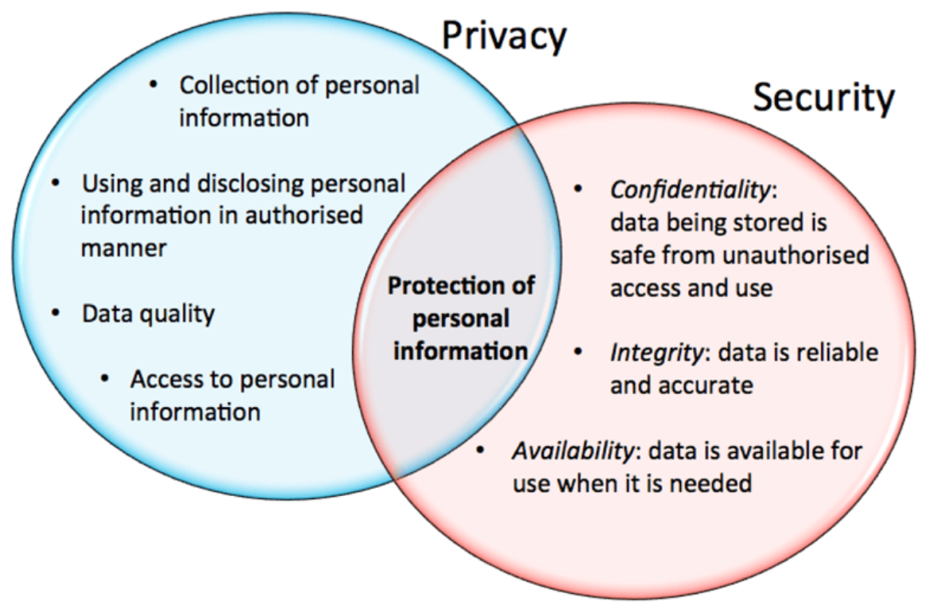
What are the ethical concerns related to the transmission of personal data?
Notes:
The ethical concerns of transmission of personal data is data privacy and and data protection.
Inappropriate use of personal data
Unauthorized access to private data that is confidential treatment of personal information
The accuracy of private data content and the data subject's legal right to access and ownership

Slide 55


